Slide 1
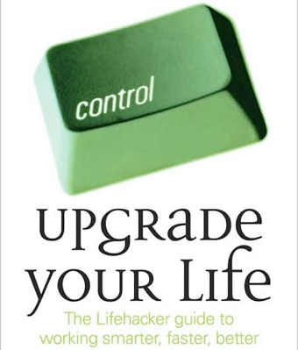

Slide 5
小型系統
心情vs.古典樂
浪漫求籤系統
美食導航系統 季潔亭雅鈺熒岱芸
楊氏音樂模擬大會考人瑋 若維 芷萱 伽倩
麥當勞熱量計算系統
火星文困擾你嗎?
歌詞知多少-挑戰你的腦容量英琪 日馨 青雪 鈺娟
http://www.fg.tp.edu.tw/~anny/

Slide 6
Winter Projects

Slide 7
Problem Solving & Programming
陳怡芬
Anny

Slide 11
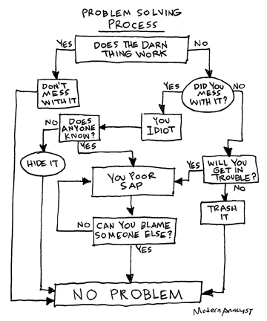

Slide 13
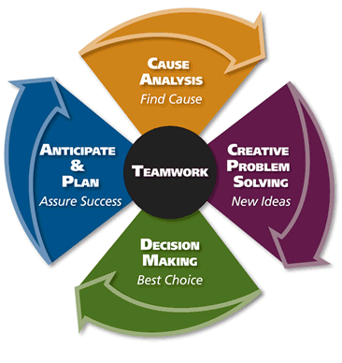

Slide 14
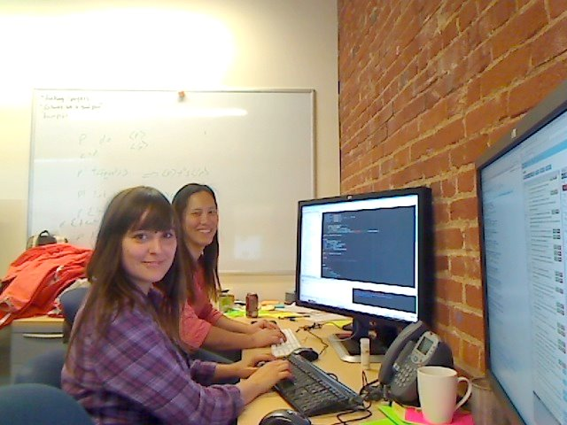
Pair Programming

Slide 15
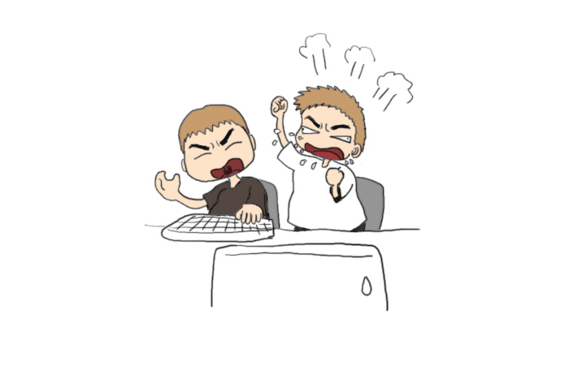

Slide 17
Pair Programming
Driver and Navigator working together on one task
Roles changing often
Collective responsibility for outcome
Bringing together of multiple perspectives, experiences, abilities, and expertise

Slide 18
Why pair?
Higher quality code
Faster cycle time
Enhanced trust/teamwork
Knowledge transfer
Enhanced learning
More fun

Slide 19
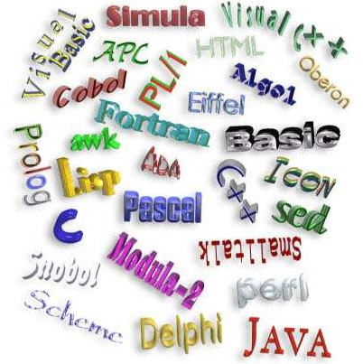

Slide 21
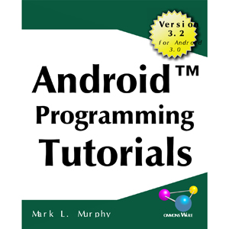

Slide 22
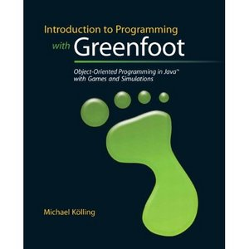

Slide 23
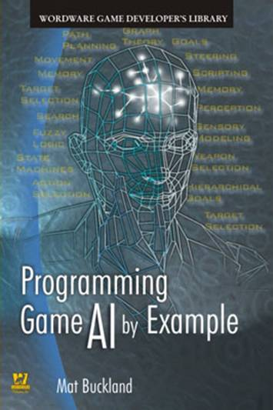
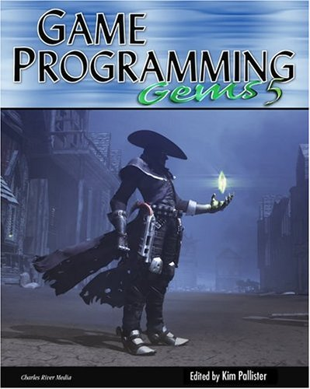

Slide 24
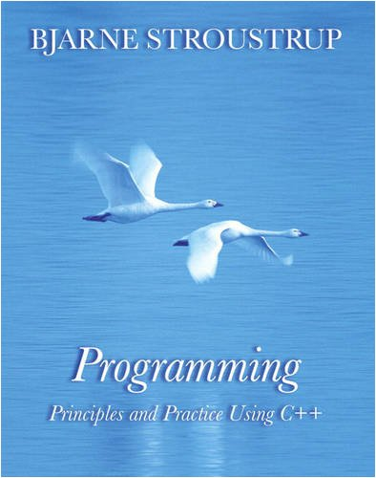
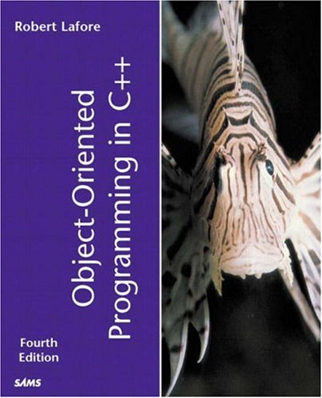

Slide 25
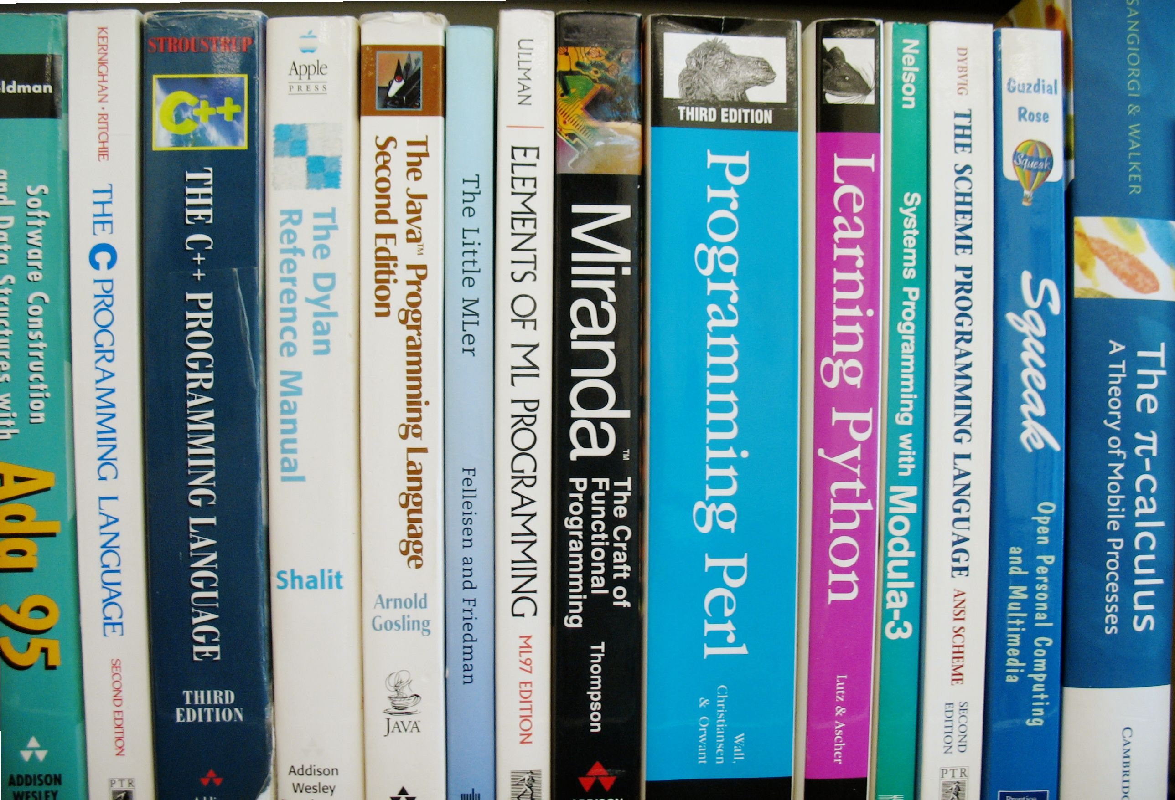

Slide 26
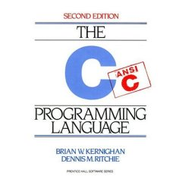

Slide 27
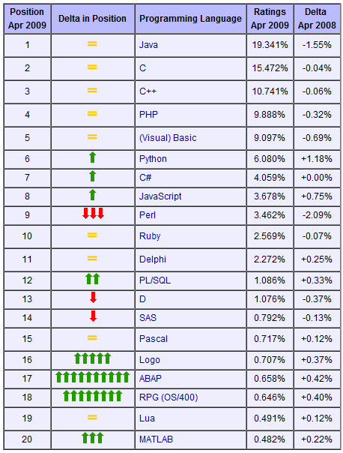
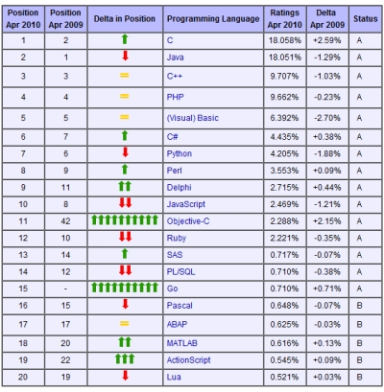

Slide 28
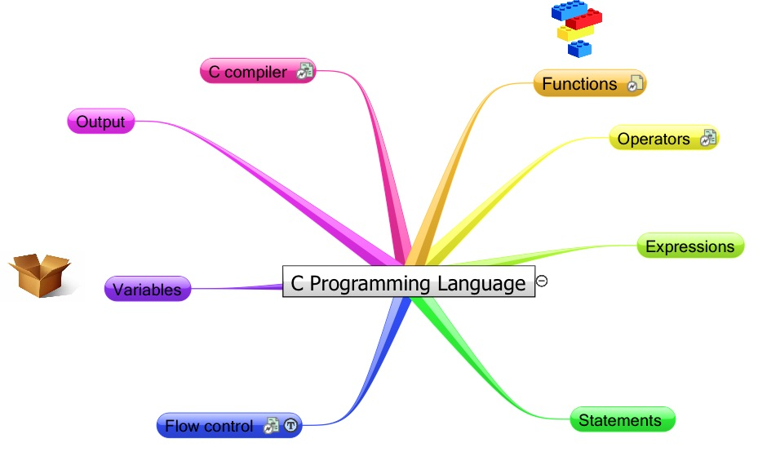

Slide 29
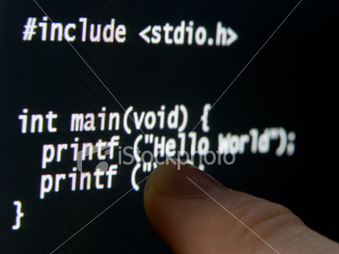

Slide 30
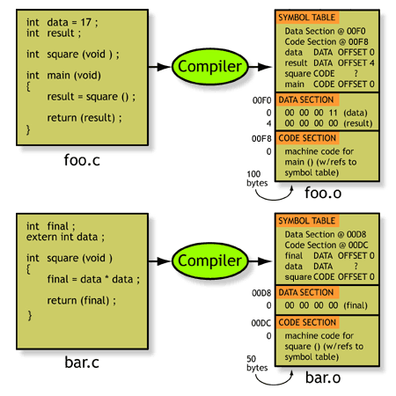

Slide 31
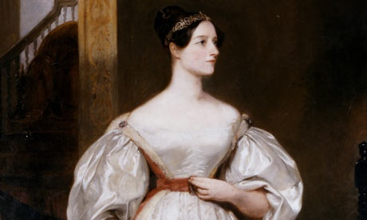
The world’s first computer programmer. You read that right, a woman was the first programmer! Born in 1815, Lovelace wrote programs for an early analytical engine built by Charles Babbage.
Women will take over the world!

Slide 32
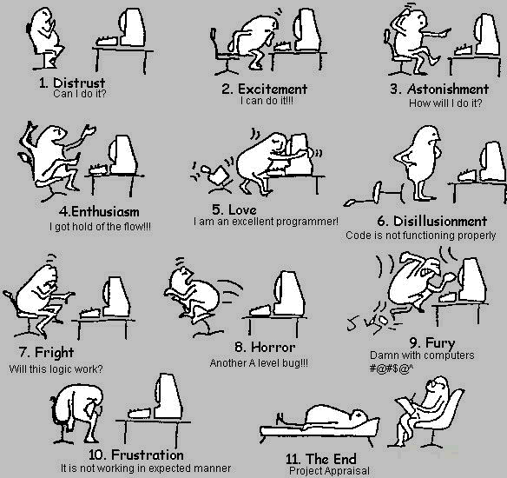
熱情能驅動他們把軟體的某一個面向雕琢到極致，這需要超乎常人的毅力和堅持，以及絕不向壓力妥協的精神…

Slide 33
The C Language
Currently, the most commonly-used language for embedded systems
High-level assembly
Very portable
compilers exist for virtually every processor
Easy-to-understand compilation
Produces efficient code
Fairly concise

Slide 34
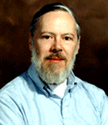
C History
Developed between 1969 and 1973 along with Unix
Due mostly to Dennis Ritchie
Designed for systems programming
Operating systems
Utility programs
Compilers
Filters

Slide 35
Computer Architecture
CPU
ALU
Input
Device
Input
Output
Output
Device
Control
Memory

Slide 36
Introduction to C Programming
Main Parts of
C Programs

Slide 38
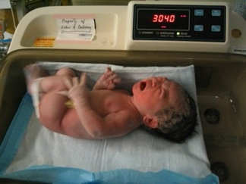
Our First C Program ⎯ Hello World

Slide 39
Our First C Program ⎯ Hello World
/* Hello.c
Our first program */
#include <stdio.h>
/* function main begins program execution */
main()
{
printf("hello, world\n");
}

Slide 40
The #include Directive
C preprocessors start with #
include information about standard library
/* Hello.c
Our first program */
#include <stdio.h>
/* function main begins program execution */
main()
{
printf("hello, world\n");
}

Slide 41
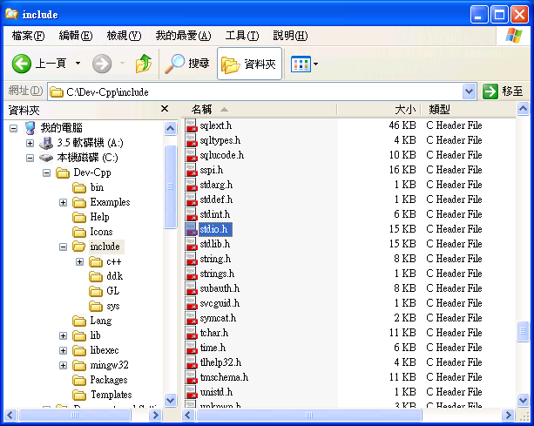
The #include Directive
C preprocessors start with #
include information about standard library
/* Hello.c
Our first program */
#include <stdio.h>
/* function main begins program execution */
main()
{
printf("hello, world\n");
}

Slide 42
Entry Point of C Programs
/* Hello.c
Our first program */
#include <stdio.h>
/* function main begins program execution */
main()
{
printf("hello, world\n");
}
define a function called main
that receives no argument
Function body

Slide 43
Function Body
/* Hello.c
Our first program */
#include <stdio.h>
/* function main begins program execution */
main()
{
printf("hello, world\n");
}
Function body starts with {
Function body
Function body ends with }

Slide 44
C Statements
/* Hello.c
Our first program */
#include <stdio.h>
/* function main begins program execution */
main()
{
printf("hello, world\n");
}
a C statement
C statements end with ;

Slide 45
Comments
/* . . . */
for multiple lines
or
//
(c++) for single line
/* Hello.c
Our first program */
#include <stdio.h>
/* function main begins program execution */
main()
{
printf("hello, world\n");
}

Slide 46
Comments
/* . . . */
for multiple lines
or
//
(c++) for single line
/* Hello.c
Our first program */
#include <stdio.h>
/* function main begins program execution */
main()
{
printf("hello, world\n");
}
// Hello.c
// Our first program
#include <stdio.h>
// function main begins program execution
main()
{
printf("hello, world\n");
}

Slide 47
Robot’s Movement

Slide 48
printf ⎯ Print formatted data to stdout
// Hello.c
// Our first program
#include <stdio.h>
// function main begins program execution
main()
{
printf("hello, world\n");
}
function
Parameter
(string)
function
name

Slide 49
#include <stdio.h> #include <stdlib.h> int main( ) { int num; printf("Input a number:"); scanf("%d",&num); if (num>=0) printf("正數"); else printf("負數"); system("PAUSE"); return 0; }

Slide 50
//程式功能：求解BMI //作者：Anny //完成日期：2005/4/1
#include <stdio.h> #include <stdlib.h> int main( ) { float height, weight, BMI; printf("height=?(m)"); scanf("%f",&height); printf("weight=?(Kg)"); scanf("%f",&weight); BMI = weight / (height * height); printf("BMI = %f \n", BMI); if (BMI < 18) printf("太輕了。\n"); else if ((BMI >=18) &&(BMI <20)) printf("穠纖合度！！ \n"); else printf("太重了喔！應注意。\n"); system("PAUSE"); return 0; }

Slide 51
printf ⎯ Print formatted data to stdout
printf("Hello, World\n");
Instructs computer to perform an action
Specifically, prints the string of characters within quotes (" ")
Entire line called a statement
All statements must end with a semicolon (;)
Escape character (\)
Indicates that printf should do something out of the ordinary
\n is the newline character

Slide 52
Some Common Escape Sequences

Slide 53
Editing → Compiling → Linking → Execution

